Slide 1
Photo Album (ENVIRONMENT)
by USER

Slide 2
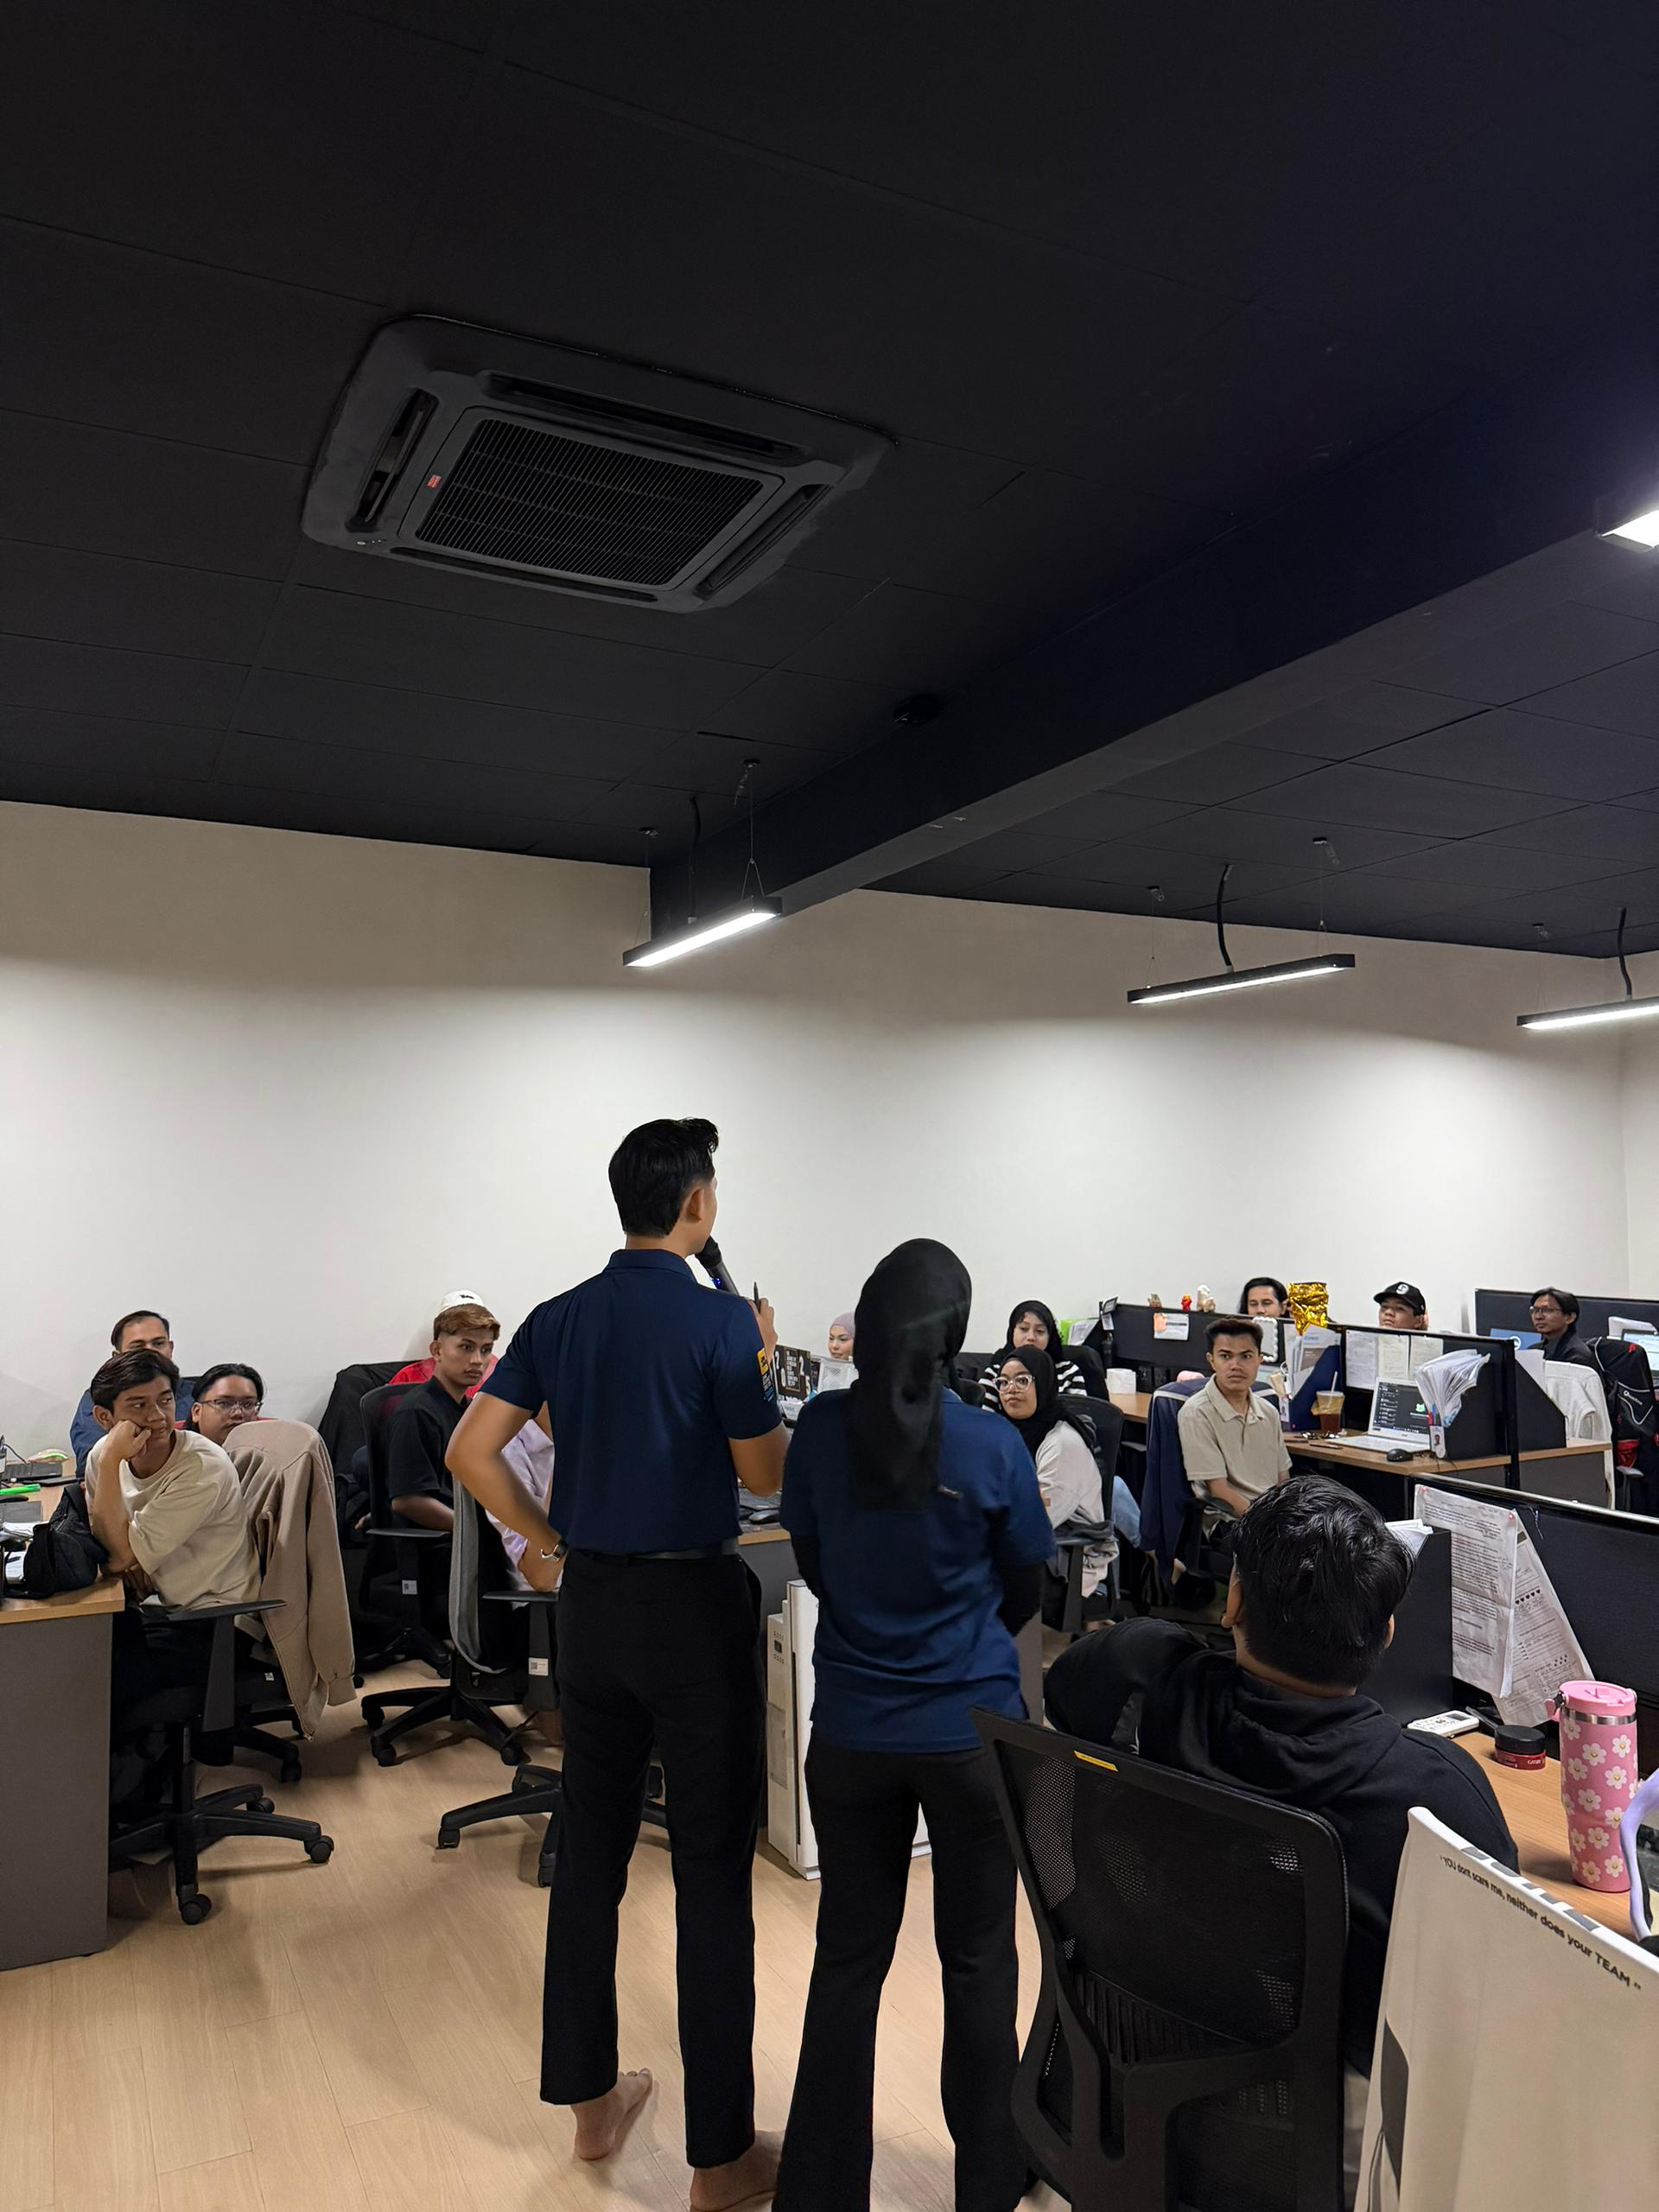

Slide 3
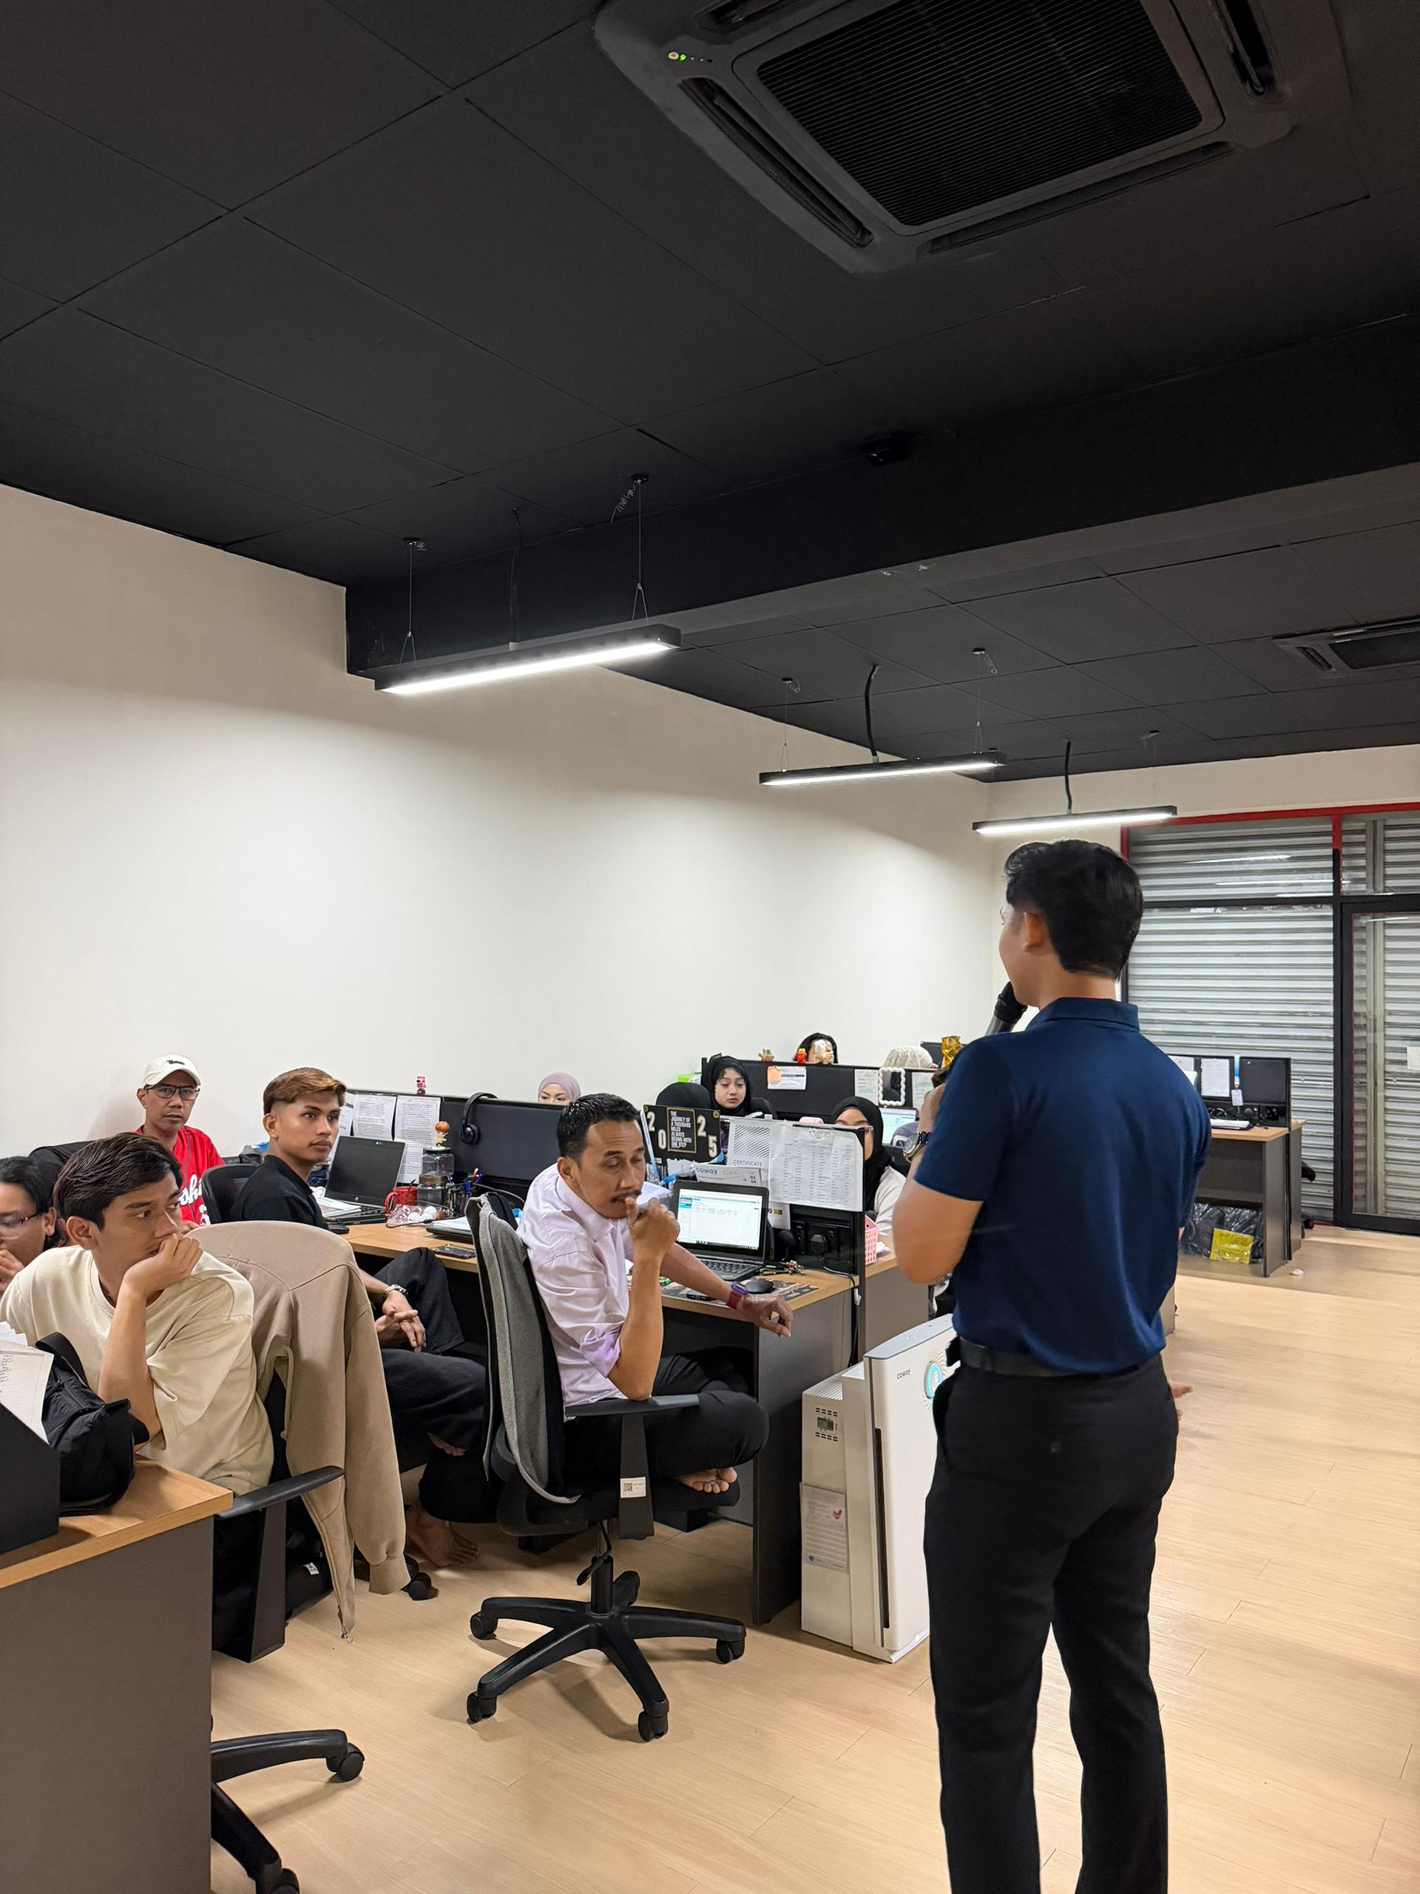

Slide 4
